Slide 1


Network protocols & security
24EC2210
Topic:
Transport layer: services
& Process-to-process delivery
Session - 24

Slide 2
Process to Process Delivery:
The data link layer is responsible for delivery of frames between two neighbouring nodes over a link. This is called Node-to-Node delivery.
The network layer is responsible for delivery of datagrams between two hosts. This is called Host-to-Host delivery.
Real communication takes place between two processes (application programs). We need Process-to-Process delivery.
The transport layer is responsible for Process-to-Process delivery-the delivery of a packet, part of a message, from one process to another.

Slide 3
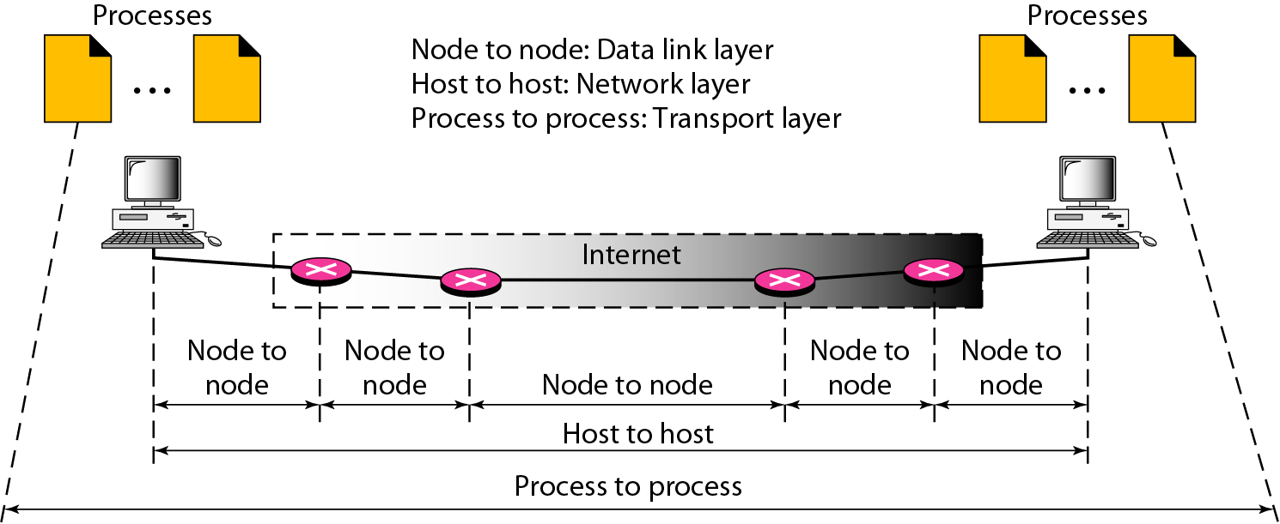
Types of Data Deliveries Node-to-Node , Host-to-Host, Process-to-Process

Slide 4
Client/Server Paradigm
Although there are several ways to achieve process-to-process communication, the most common one is through the client/server paradigm.
A process on the local host, called a client, needs services from a process usually on the remote host, called a server.
1. Local host
2. Local process
3. Remote host
4. Remote process

Slide 5
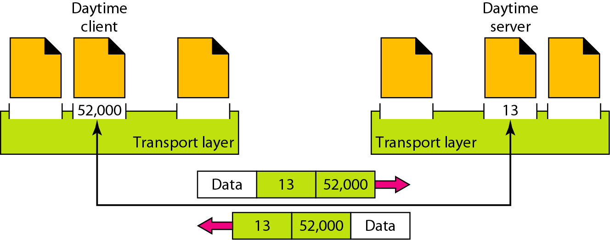
Addressing
In transport layer, the source and destination processes are identified by a port number.

Slide 6
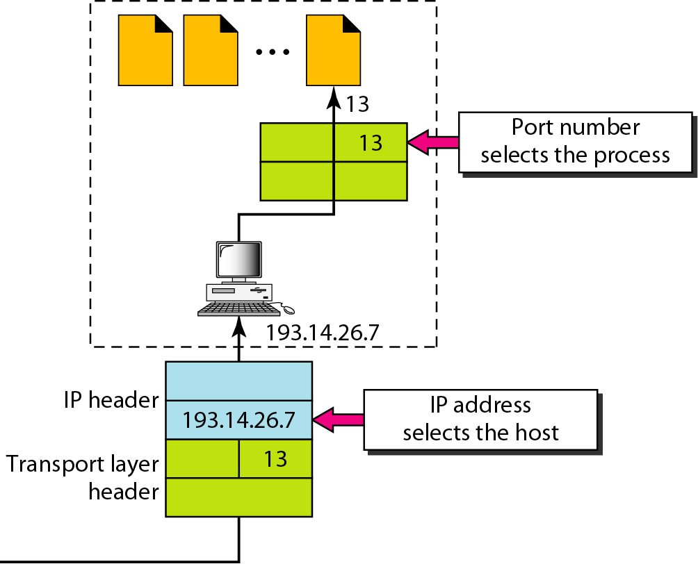
Addressing…
The IP addresses and port numbers play different roles in selecting the final destination of data.
The destination IP address defines the host among the different hosts in the world.
After the host has been selected, the port number defines one of the processes on this particular host.

Slide 7
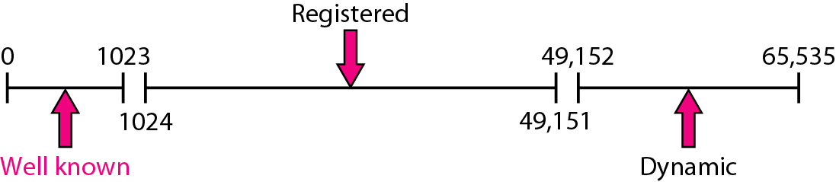
Figure 23.4 IANA (Internet Assigned Number Authority) ranges

Slide 8
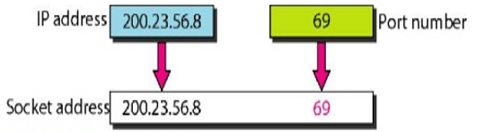
Socket Address
A socket address is the combination of an IP address (the location of the computer) and a port number (which is mapped to the application program process) into a single identity
FIG. SOCKET ADDRES

Slide 9
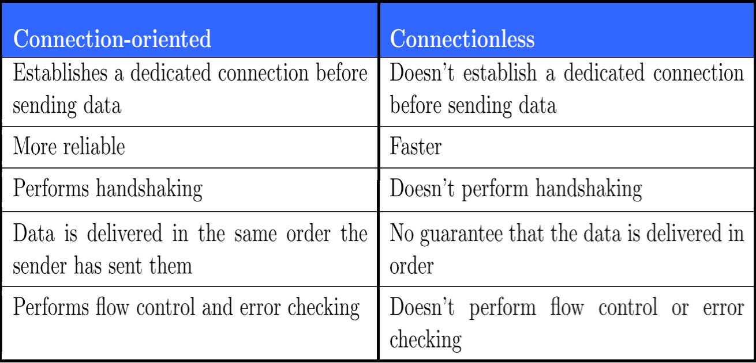
Transport Layer Services
A transport layer protocol can either be connectionless or connection-oriented.

Slide 10
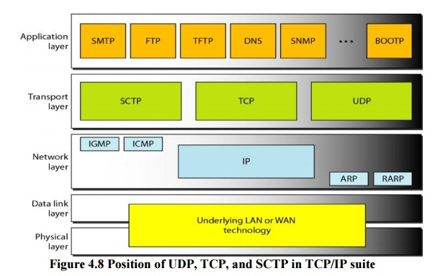
Transport layer Protocols
SCTP(Stream Control Transmission Protocol)
TCP (Transmission Control Protocol)
UDP (User Datagram Protocol)

Slide 11
THANK YOU
Team –Network Protocols and Security

